Slide 1
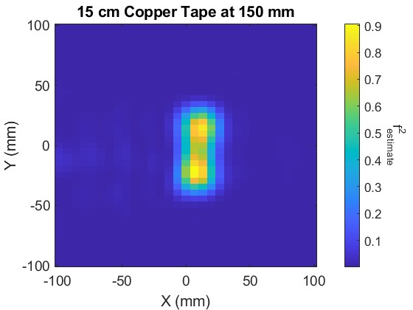
MATLAB Image Reconstruction using real-world data
ISAR_Image_Reconstruction.m
Using CopperTape_15cm.mat and
ProbeResponse2.mat

Slide 2
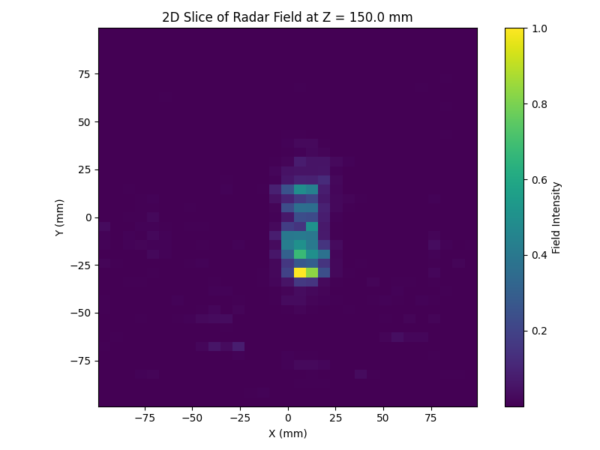
Image Reconstruction using InstantNGP Model
train.py from NRF Repository
Using CopperTape_15cm.mat and
ProbeResponse2.mat
test_model.ipynb

Slide 3
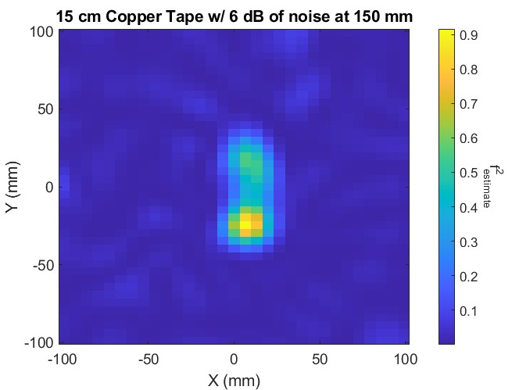
MATLAB Image Reconstruction using real-world data with noise
ISAR_Image_Reconstruction.m
Using CopperTape_15cm_6dB_noise.mat and
ProbeResponse2.mat

Slide 4
Image Reconstruction with 6 dB noise using InstantNGP Model
train.py from NRF Repository
Using CopperTape_15cm_6dB_noise.mat and
ProbeResponse2.mat
test_model.ipynb

Slide 5
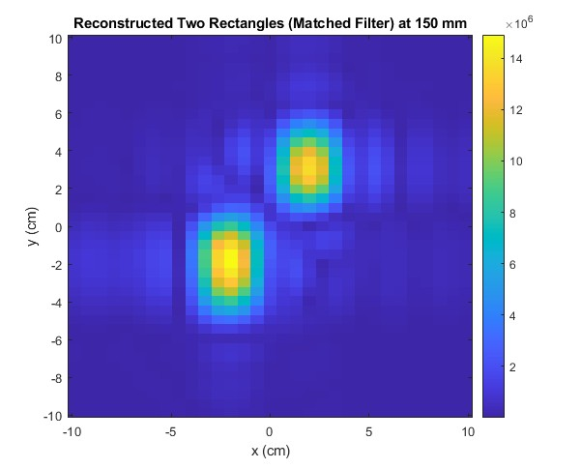
MATLAB Image Reconstruction using synthetic data
ISAR_synthetic_reconstruction.m

Slide 6
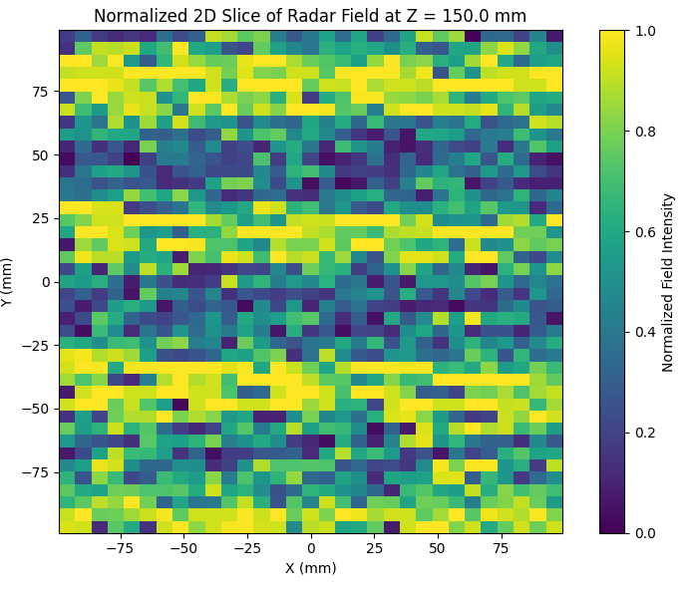
Image Reconstruction using synthetic data on InstantNGP model
Synth_train_v2.py
test_model.ipynb

